Slide 1
Network Security Essentials
Chapter 4
Fourth Edition
by William Stallings
Notes:
Lecture slides by Lawrie Brown for “Network Security Essentials”, 4/e, by William Stallings, Chapter 4 – “Key Distribution and User Authentication”.

Slide 2
Outline
Key distribution (Ref. Chap.14)
User authentication: Kerberos (Ref. Chap.15)
Public-key certificate (Ref. Chap.14)
Public-key infrastructure (Ref. Chap.14)

Slide 3
Key Management and Distribution
Topics of cryptographic key management / key distribution are complex
  Cryptographic, protocol, & management issues
Symmetric schemes require both parties to share a common secret key
Public key schemes require parties to acquire valid public keys
Have concerns with doing both
Notes:
The topics of cryptographic key management and cryptographic key distribution are complex, involving cryptographic, protocol, and management considerations. The purpose of this chapter is to give the reader a feel for the issues involved and a broad survey of the various aspects of key management and distribution.

Slide 4
Key Distribution
Symmetric schemes require both parties to share a common secret key
Issue is how to securely distribute this key whilst protecting it from others
Frequent key changes can be desirable
Often secure system failure due to a break in the key distribution scheme
Notes:
For symmetric encryption to work, the two parties to an exchange must share the same key, and that key must be protected from access by others. Furthermore, frequent key changes are usually desirable to limit the amount of data compromised if an attacker learns the key. This is one of the most critical areas in security systems - on many occasions systems have been broken, not because of a poor encryption algorithm, but because of poor key selection or management. It is absolutely critical to get this right!

Slide 5
Key Distribution
Given parties A and B have various key distribution alternatives:
  A can select key and physically deliver to B
  Third party can select & deliver key to A & B
  Uf A & B have communicated previously can use previous key to encrypt a new key
  If A & B have secure communications with a third party C, C can relay key between A & B
Notes:
The strength of any cryptographic system thus depends on the key distribution technique. For two parties A and B, key distribution can be achieved in a number of ways:
Physical delivery (1 & 2) is simplest - but only applicable when there is personal contact between recipient and key issuer. This is fine for link encryption where devices & keys occur in pairs, but does not scale as number of parties who wish to communicate grows (see next slide). 3 is mostly based on 1 or 2 occurring first, and also suffers that if an attacker ever succeeds in gaining access to one key, then all subsequent keys will be revealed.
A third party, whom all parties trust, can be used as a trusted intermediary to mediate the establishment of secure communications between them (4). Must trust intermediary not to abuse the knowledge of all session keys. As number of parties grow, some variant of 4 is only practical solution to the huge growth in number of keys potentially needed.

Slide 6
Option 4
Elements in option 4
  Key distribution center (KDC)
  Session key: valid for the duration of a logical connection
  Permanent key: for distributing session keys
Steps
  Connection request: A -> KDC
  Connection approval: KDC generates unique one-time session key, and send to A and B
  Data exchange using session key: A <-> B

Slide 7
Kerberos
Trusted key server system from MIT
Provides centralised private-key third-party authentication in a distributed network
  Allows users access to services distributed through network
  Without needing to trust all workstations
  Rather all trust a central authentication server
Two versions in use: 4 & 5 (RFC 4120)
Notes:
Kerberos is an authentication service developed as part of Project Athena at MIT, and is one of the best known and most widely implemented trusted third party key distribution systems.
Kerberos provides a centralized authentication server whose function is to authenticate users to servers and servers to users. Unlike most other authentication schemes, Kerberos relies exclusively on symmetric encryption, making no use of public-key encryption. Two versions of Kerberos are in common use: v4 & v5.

Slide 8
Kerberos Requirements
Its first report identified requirements as:
  Secure
  Reliable
  Transparent
  Scalable
Implemented using an authentication protocol based on Needham-Schroeder
Notes:
In a more open environment, in which network connections to other machines are supported, an approach that requires the user to prove his or her identity for each service invoked, and also require that servers prove their identity to clients, is needed to protect user information and resources housed at the server. Kerberos supports this approach, and assumes a distributed client/server architecture that employs one or more Kerberos servers to provide an authentication service. The first published report on Kerberos [STEI88] listed the following requirements:
• Secure: A network eavesdropper should not be able to obtain the necessary information to impersonate a user. More generally, Kerberos should be strong enough that a potential opponent does not find it to be the weak link.
• Reliable: For all services that rely on Kerberos for access control, lack of availability of the Kerberos service means lack of availability of the supported services. Hence, Kerberos should be highly reliable and should employ a distributed server architecture, with one system able to back up another.
• Transparent: Ideally, the user should not be aware that authentication is taking place, beyond the requirement to enter a password.
• Scalable: The system should be capable of supporting large numbers of clients and servers. This suggests a modular, distributed architecture.
To support these requirements, Kerberos is a trusted third-party authentication service that uses a protocol based on that proposed by Needham and Schroeder which was discussed earlier in this chapter.

Slide 9
A Simple Authentication Dialogue
To prevent impersonation
  C → V: ID_{C}||P_{C}
  Burden on each server
Authentication server (AS)
  C→AS: ID_{C}||P_{C}||ID_{V}
  AS→C: Ticket
  C→V: ID_{C}||Ticket
  Ticket=E(K_{v}, [ID_{C}||AD_{C}||ID_{V}])

Slide 10
A More Secure Authentication Dialogue
Problems with the previous scenario
  A user has to enter a password many times
    Once for every different service
  Plaintext transmission of the password

Slide 11
Ticket-granting server (TGS)
  Once per user logon session
    C→AS: ID_{C}||ID_{tgs}
    AS→C: E(K_{C}, Ticket_{tgs})
  Once per type of service
    C->TGS: ID_{C}||ID_{V}||Ticket_{tgs}
    TGS→C: Ticket_{v}
  Once per server session
    C→V: ID_{C}||Ticket_{v}
  Ticket_{tgs}=E(K_{tgs}, [ID_{C}||AD_{C}||ID_{tgs}||TS₁||Lifetime₁])
  Ticket_{v}=E(K_{v}, [ID_{C}||AD_{C}||ID_{V}||TS₂||Lifetime₂])

Slide 12
Problems
  Lifetime of the tickets
    A network service must be able to prove that the person using the ticket is the same person to whom the ticket was issued
    Session key in Kerberos
  Servers need to authenticate themselves to users
    Mutual authentication

Slide 13
Kerberos v4 Overview
A basic third-party authentication scheme
Have an Authentication Server (AS)
  Users initially negotiate with AS to identify self
  AS provides a non-corruptible authentication credential (ticket granting ticket TGT)
Have a Ticket Granting server (TGS)
  Users subsequently request access to other services from TGS on basis of users TGT
Using a complex protocol using DES
Notes:
The core of Kerberos is the Authentication and Ticket Granting Servers – these are trusted by all users and servers and must be securely administered. The protocol includes a sequence of interactions between the client, AS, TGT and desired server. Version 4 of Kerberos makes use of DES, in a rather elaborate protocol, to provide the authentication service. Viewing the protocol as a whole, it can be difficult to see the need for the many elements contained therein. The text contains more detailed discussion about the development of and need for the components of the final v4 protocol.

Slide 14
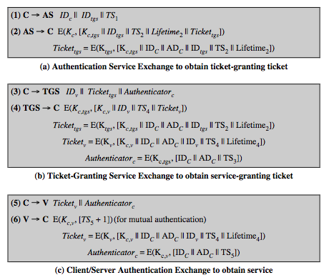
Kerberos v4 Dialogue
Notes:
The full Kerberos v4 authentication dialogue is shown here from Stallings Table 15.1, divided into 3 phases. The justification for each item in the messages is given in Stallings Table 4.1.
First, consider the problem of captured ticket-granting tickets and the need to determine that the ticket presenter is the same as the client for whom the ticket was issued. An efficient way of doing this is to use a session encryption key to secure information. Table 15.1a shows the technique for distributing the session key. Note that several additional pieces of information have been added to this first phase of the dialogue. Message (1) includes a timestamp, so that the AS knows that the message is timely. Message (2) includes several elements of the ticket in a form accessible to C. This enables C to confirm that this ticket is for the TGS and to learn its expiration time. Note that the ticket does not prove anyone's identity but is a way to distribute keys securely. It is the authenticator that proves the client's identity. Because the authenticator can be used only once and has a short lifetime, the threat of an opponent stealing both the ticket and the authenticator for presentation later is countered. C then sends the TGS a message that includes the ticket plus the ID of the requested service (message 3). The reply from the TGS, in message (4), follows the form of message (2). C now has a reusable service-granting ticket for V. When C presents this ticket, as shown in message (5), it also sends an authenticator. The server can decrypt the ticket, recover the session key, and decrypt the authenticator. If mutual authentication is required, the server can reply as shown in message (6)

Slide 15
Authentication service exchange to obtain ticket-granting ticket
  C→AS: ID_{C}||ID_{tgs}||TS₁
  AS→C: E(K_{C}, [K_{C,tgs}||ID_{tgs}||TS₂||Lifetime₂||Ticket_{tgs}])
  Ticket_{tgs}=E(K_{tgs}, [K_{C,tgs}|| ID_{C}||AD_{C}||ID_{tgs}||TS₂||Lifetime₂])
[Session key: K_{C,tgs}]

Slide 16
Ticket-granting service exchange to obtain ticket-granting ticket
  C->TGS: ID_{V}||Ticket_{tgs}||Authenticator_{C}
  TGS→C: E(K_{C,tgs ,} [K_{c,v}||ID_{v}||TS₄||Ticket_{v}])
  Ticket_{tgs}=E(K_{tgs}, [K_{C,tgs}|| ID_{C}||AD_{C}||ID_{tgs}||TS₂||Lifetime₂])
  Ticket_{v}=E(K_{v}, [K_{c,v}|| ID_{C}||AD_{C}||ID_{V}||TS₄||Lifetime₄])
  Authenticator_{C} = E(K_{C,tgs,} [ID_{C}||AD_{C}||TS₃])
[Session key: K_{C,v}]

Slide 17
Client/Server Authentication Exchange to obtain service
  C→V: Ticket_{v}||Authenticator_{C}
  V→C: E(K_{c,v}, [TS₅+1]) (for mutual authentication)
  Ticket_{v}=E(K_{v}, [K_{c,v} || ID_{C}||AD_{C}||ID_{V}||TS₄||Lifetime₄])
  Authenticator_{C} = E(K_{C,v,} [ID_{C}||AD_{C}||TS₅])

Slide 18
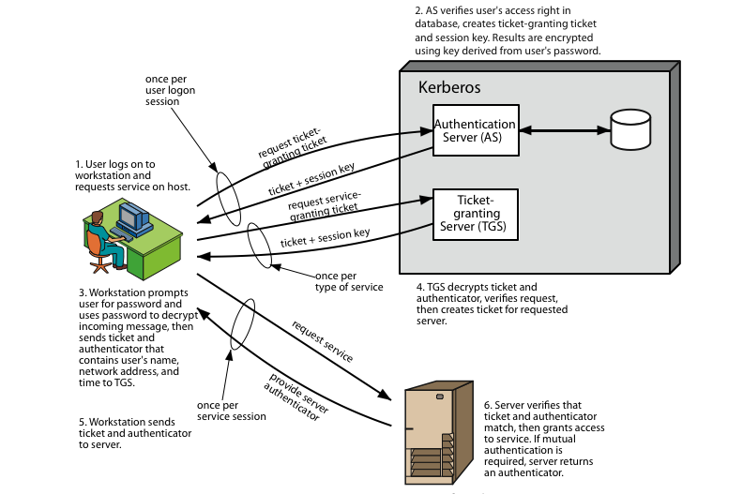
Kerberos 4 Overview
Notes:
Stallings Figure 4.1 diagrammatically summarizes the Kerberos v4 authentication dialogue, with 3 pairs of messages, for each phase listed previously.

Slide 19
Kerberos Realms
A Kerberos environment consists of:
  A Kerberos server
  A number of clients, all registered with server
  Application servers, sharing keys with server
This is termed a realm
  Typically a single administrative domain
In multiple realms, their Kerberos servers must share keys and trust
Notes:
A full-service Kerberos environment consisting of a Kerberos server, a number of clients, and a number of application servers is referred to as a Kerberos realm. A Kerberos realm is a set of managed nodes that share the same Kerberos database, and are part of the same administrative domain. If have multiple realms, their Kerberos servers must share keys and trust each other.

Slide 20
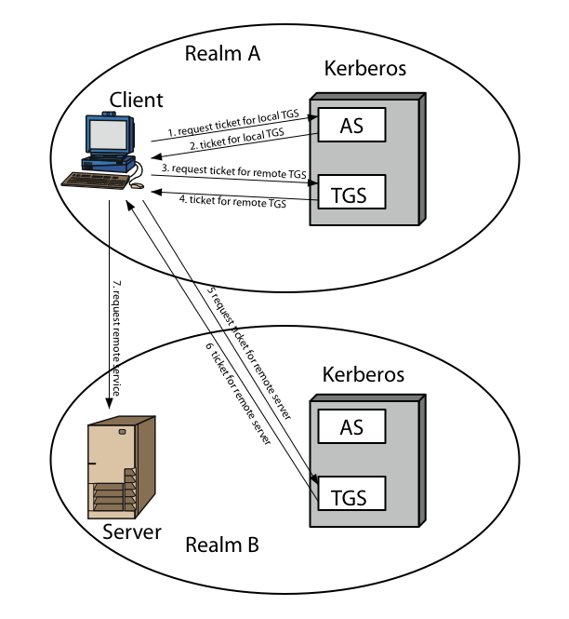
Kerberos Realms
Notes:
Stallings Figure 4.2 shows the authentication messages where service is being requested from another domain. The ticket presented to the remote server indicates the realm in which the user was originally authenticated. The server chooses whether to honor the remote request. One problem presented by the foregoing approach is that it does not scale well to many realms, as each pair of realms need to share a key.

Slide 21
  C→AS: ID_{C}||ID_{tgs}||TS₁
  AS→C: E(K_{C}, [K_{C,tgs}||ID_{tgs}||TS₂||Lifetime₂||Ticket_{tgs}])
  C->TGS: ID_{tgsrem}||Ticket_{tgs}||Authenticator_{C}
  TGS→C: E(K_{C,tgs ,} [K_{c,tgsrem}||ID_{tgsrem}||TS₄||Ticket_{tgsrem}])
  C->TGS_{rem}: ID_{Vrem}||Ticket_{tgsrem}||Authenticator_{C}
  TGS_{rem}→C: E(K_{C,tgsrem,} [K_{c,vrem}||ID_{vrem}||TS₆||Ticket_{vrem}])
  C→V_{rem}: Ticket_{vrem}||Authenticator_{C}

Slide 22
Kerberos Version 5
Developed in mid 1990’s (RFC1510)
Specified as Internet standard (RFC 4120)
Provides improvements over v4
  Addresses environmental shortcomings
    Encryption alg, network protocol, byte order, ticket lifetime, authentication forwarding, interrealm auth
  And technical deficiencies
    Double encryption, non-std mode of use, session keys, password attacks
Notes:
Kerberos Version 5 is specified in RFC 1510 and provides a number of improvements over version 4 in the areas of environmental shortcomings and technical deficiencies, in areas as noted. See Stallings Table 14.3 for details of the Kerberos v5 authentication dialogue.

Slide 23
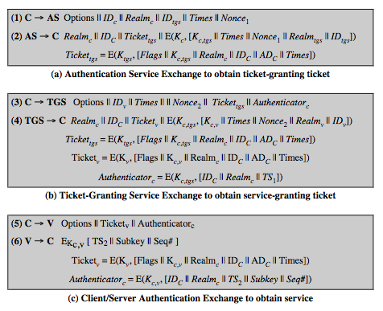
Kerberos v5 Dialogue
Notes:
The basic Kerberos version 5 authentication dialogue is shown here from Stallings Table 4.3. First, consider the authentication service exchange.
Message (1) is a client request for a ticket-granting ticket.
Message (2) returns a ticket-granting ticket, identifying information for the client, and a block encrypted using the encryption key based on the user's password. This block includes the session key to be used between the client and the TGS.
Now compare the ticket-granting service exchange for versions 4 and 5. See that message (3) for both versions includes an authenticator, a ticket, and the name of the requested service. In addition, version 5 includes requested times and options for the ticket and a nonce, all with functions similar to those of message (1). The authenticator itself is essentially the same as the one used in version 4. Message (4) has the same structure as message (2), returning a ticket plus information needed by the client, the latter encrypted with the session key now shared by the client and the TGS. Finally, for the client/server authentication exchange, several new features appear in version 5, such as a request for mutual authentication. If required, the server responds with message (6) that includes the timestamp from the authenticator. The flags field included in tickets in version 5 supports expanded functionality compared to that available in version 4. Stallings Table 15.4 summarizes the flags that may be included in a ticket., with discussion of details in the text.

Slide 24
Key distribution using asymmetric encryption
Distribution of public keys
Use of public-key encryption to distribute secret keys

Slide 25
Public-Key Certificates
To send or broadcast public keys to the community is convenient, but
  Anyone can forge such announcement
Public-key certificate
  CA: certificate authority
  Certificate: (public key + user ID) signed by CA

Slide 26
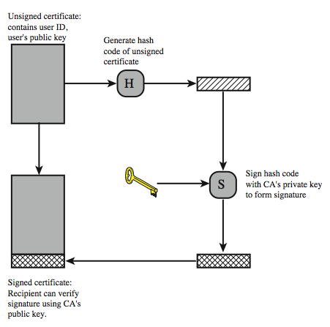
X.509 Certificate Use
Notes:
X.509 is based on the use of public-key cryptography and digital signatures. The standard does not dictate the use of a specific algorithm but recommends RSA. The digital signature scheme is assumed to require the use of a hash function. Again, the standard does not dictate a specific hash algorithm. The 1988 recommendation included the description of a recommended hash algorithm; this algorithm has since been shown to be insecure and was dropped from the 1993 recommendation. Stallings Figure 4.3 illustrates the generation of a public-key certificate.

Slide 27
Public-key distribution of secret keys
How to distribute the secret key between Alice and Bob?
  Diffie-Hellman key exchange
    No authentication of the two communicating partners
  Public-key certificate
    Encrypt the message with one-time session key
    Encrypt the session key using public-key encryption with Alice’s public key
    Attach the encrypted session key to the message

Slide 28
X.509 Certificates
ITU-T X.509
  A part of X.500 directory service
    Database of information about users
  A framework for providing authentication services by X.500 directory to its users
  A repository of public-key certificates
  Used in S/MIME (Chap.7), IP security (Chap.8), SSL/TLS (Chap.5)
  First issued in 1988, revised recommendation in 1993, third version in 1995 and revised in 2000
  Does not dictate the use of a specific alg but recommends RSA

Slide 29
X.509 Certificates
Issued by a Certification Authority (CA), containing:
  version V (1, 2, or 3)
  serial number SN (unique within CA) identifying certificate
  signature algorithm identifier AI
  issuer X.500 name CA
  period of validity TA (from - to dates)
  subject X.500 name A (name of owner)
  subject public-key info Ap (algorithm, parameters, key)
  issuer unique identifier (v2+)
  subject unique identifier (v2+)
  extension fields (v3)
  signature (of hash of all fields in certificate)
Notation CA<<A>> denotes certificate for A signed by CA
Notes:
The heart of the X.509 scheme is the public-key certificate associated with each user. There are 3 versions, with successively more info in the certificate - must be v2 if either unique identifier field exists, must be v3 if any extensions are used. These user certificates are assumed to be created by some trusted certification authority (CA) and placed in the directory by the CA or by the user. The directory server itself is not responsible for the creation of public keys or for the certification function; it merely provides an easily accessible location for users to obtain certificates. The certificate includes the elements shown, see text for further details.
The standard uses the notation for a certificate of: CA<<A>> where the CA signs the certificate for user A with its private key. In more detail CA<<A>> = CA {V, SN, AI, CA, UCA, A, UA, Ap, TA}. If the corresponding public key is known to a user, then that user can verify that a certificate signed by the CA is valid. This is the typical digital signature approach illustrated in Stallings Figure 13.2.

Slide 30
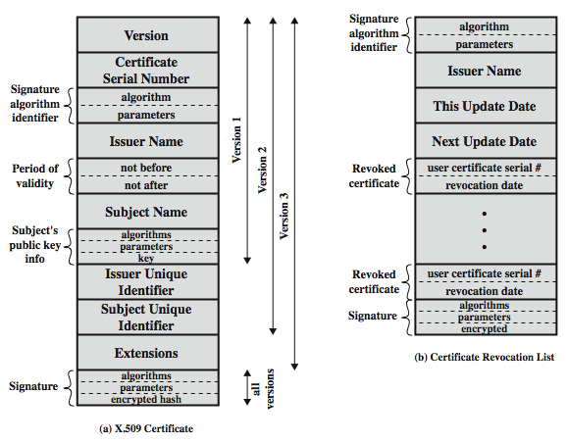
X.509 Certificates
Notes:
Stallings Figure 4.4 shows the format of an X.509 certificate and CRL (see later).

Slide 31
Obtaining a Certificate
Any user with access to CA can get any certificate from it
Only the CA can modify a certificate
Because cannot be forged, certificates can be placed in a public directory
Notes:
User certificates generated by a CA have the characteristics that any user with access to the public key of the CA can verify the user public key that was certified, and no party other than the certification authority can modify the certificate without this being detected. Because certificates are unforgeable, they can be placed in a directory without the need for the directory to make special efforts to protect them.

Slide 32
CA Hierarchy
If both users share a common CA then they are assumed to know its public key
Otherwise CA's must form a hierarchy
Use certificates linking members of hierarchy to validate other CA's
  Each CA has certificates for clients (forward) and parent (backward)
Each client trusts parents certificates
Enable verification of any certificate from one CA by users of all other CAs in hierarchy
Notes:
If both parties use the same CA, they know its public key and can verify others certificates. If there is a large community of users, it may not be practical for all users to subscribe to the same CA. With many users, it may be more practical for there to be a number of CAs, each of which securely provides its public key to some fraction of the users. Hence there has to be some means to form a chain of certifications between the CA's used by the two parties, by the use of client and parent certificates. All these certificates of CAs by CAs need to appear in the directory, and the user needs to know how they are linked to follow a path to another user's public-key certificate. X.509 suggests that CAs be arranged in a hierarchy so that navigation is straightforward. It is assumed that each client trusts its parents certificates.

Slide 33
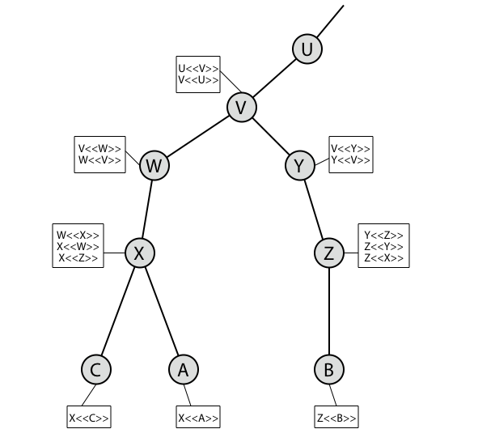
CA Hierarchy Use
Notes:
Stallings Figure 4.6 illustrates the use of an X.509 hierarchy to mutually verify clients certificates. The connected circles indicate the hierarchical relationship among the CAs; the associated boxes indicate certificates maintained in the directory for each CA entry. The directory entry for each CA includes two types of certificates: Forward certificates: Certificates of X generated by other CAs, and Reverse certificates: Certificates generated by X that are the certificates of other CAs.
In this example, we can track chains of certificates as follows:
A acquires B certificate using chain: X<<W>>W<<V>>V<<Y>>Y<<Z>>Z<<B>>
B acquires A certificate using chain: Z<<Y>>Y<<V>>V<<W>>W<<X>>X<<A>>

Slide 34
Certificate Revocation
Certificates have a period of validity
May need to revoke before expiry, eg:
  User's private key is compromised
  User is no longer certified by this CA
  CA's certificate is compromised
CA’s maintain list of revoked certificates
  The Certificate Revocation List (CRL)
Users should check certificates with CA’s CRL
Notes:
A certificate includes a period of validity. Typically a new certificate is issued just before the expiration of the old one.
In addition, it may be desirable on occasion to revoke a certificate before it expires, for one of a range of reasons, such as those shown above.
To support this, each CA must maintain a list consisting of all revoked but not expired certificates issued by that CA, known as the certificate revocation list (CRL). Each certificate revocation list (CRL) posted to the directory is signed by the issuer and includes (as shown in Stallings Figure 14.14b previously) the issuer's name, the date the list was created, the date the next CRL is scheduled to be issued, and an entry for each revoked certificate. Each entry consists of the serial number of a certificate and revocation date for that certificate. Because serial numbers are unique within a CA, the serial number is sufficient to identify the certificate.
When a user receives a certificate in a message, the user must determine whether the certificate has been revoked, by checking the directory CRL each time a certificate is received, this often does not happen in practice.

Slide 35
X.509 Version 3
Has been recognised that additional information is needed in a certificate
  Email/URL, policy details, usage constraints
Rather than explicitly naming new fields defined a general extension method
Extensions consist of:
  Extension identifier
  Criticality indicator
  Extension value
Notes:
The X.509 version 2 format does not convey all of the information that recent design and implementation experience has shown to be needed. Rather than continue to add fields to a fixed format, standards developers felt that a more flexible approach was needed. X.509 version 3 includes a number of optional extensions that may be added to the version 2 format. Each extension consists of an extension identifier, a criticality indicator, and an extension value. The criticality indicator indicates whether an extension can be safely ignored or not (in which case if unknown the certificate is invalid).

Slide 36
Certificate Extensions
Key and policy information
  Convey info about subject & issuer keys, plus indicators of certificate policy
Certificate subject and issuer attributes
  Support alternative names, in alternative formats for certificate subject and/or issuer
Certificate path constraints
  Allow constraints on use of certificates by other CA’s
Notes:
The certificate extensions fall into three main categories:
key and policy information - convey additional information about the subject and issuer keys, plus indicators of certificate policy. A certificate policy is a named set of rules that indicates the applicability of a certificate to a particular community and/or class of application with common security requirements.
subject and issuer attributes - support alternative names, in alternative formats, for a certificate subject or certificate issuer and can convey additional information about the certificate subject; eg. postal address, email address, or picture image
certification path constraints - allow constraint specifications to be included in certificates issued for CA’s by other CA’s that may restrict the types of certificates that can be issued by the subject CA or that may occur subsequently in a certification chain.

Slide 37
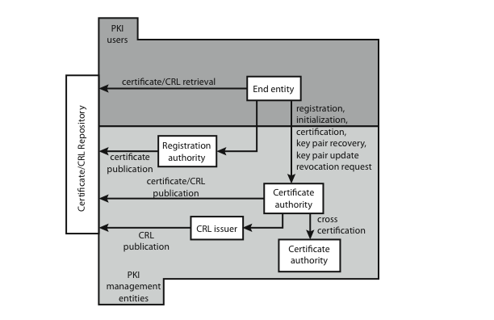
Public Key Infrastructure
Notes:
RFC 2822 (Internet Security Glossary) defines public-key infrastructure (PKI) as the set of hardware, software, people, policies, and procedures needed to create, manage, store, distribute, and revoke digital certificates based on asymmetric cryptography. Its principal is to enable secure, convenient, and efficient acquisition of public keys. The IETF Public Key Infrastructure X.509 (PKIX) working group has setup a formal (and generic) model based on X.509 that is suitable for deploying a certificate-based architecture on the Internet.
Stallings Figure 4.7 shows interrelationships among some key elements:
• End entity: A generic term used to denote end users, devices (e.g., servers, routers), or any other entity that can be identified in the subject field of a public key certificate. End entities canconsume and/or support PKI-related services.
• Certification authority (CA): The issuer of certificates and (usually) certificate revocation lists (CRLs). It may also support a variety of administrative functions, although these are often delegated to Registration Authorities.
• Registration authority (RA): An optional component that can assume a number of administrative functions from the CA. The RA is often associated with the End Entity registration process, but can assist in a number of other areas as well.
• CRL issuer: An optional component that a CA can delegate to publish CRLs.
• Repository: A generic term used to denote any method for storing certificates and CRLs so that they can be retrieved by End Entities.

Slide 38
PKIX Management
Functions:
  Registration
  Initialization
  Certification
  Key pair recovery
  Key pair update
  Revocation request
  Cross certification
Protocols: CMP (RFC 2510), CMC (RFC 2797)
Notes:
PKIX identifies a number of management functions that potentially need to be supported by management protocols, as shown in Figure 14.16:
• Registration: whereby a user first makes itself known to a CA, prior to issue of a certificate(s) for that user. It usually involves some off-line or online procedure for mutual authentication.
• Initialization: to install key materials that have the appropriate relationship with keys stored elsewhere in the infrastructure.
• Certification: process where a CA issues a certificate for a user's public key, and returns it to the user's client system and/or posts it in a repository.
• Key pair recovery: a mechanism to recover the necessary decryption keys when normal access to the keying material is no longer possible.
• Key pair update: key pairs need to be updated and new certificates issued.
• Revocation request: when authorized person advises need for certificate revocation, e.g. private key compromise, affiliation change, name change.
• Cross certification: when two CAs exchange information used in establishing a cross-certificate, issued by one CA to another CA that contains a CA signature key used for issuing certificates.
The PKIX working group has defines two alternative management protocols between PKIX entities. RFC 2510 defines the certificate management protocols (CMP), which is a flexible protocol able to accommodate a variety of technical, operational, and business models. RFC 2797 defines certificate management messages over CMS (RFC 2630) called CMC. This is built on earlier work to leverage existing code.

Slide 39
Federated Identity Management
Use of common identity management scheme
  Across multiple enterprises & numerous applications
  Supporting many thousands, even millions of users
Principal elements are:
  Authentication, authorization, accounting, provisioning, workflow automation, delegated administration, password synchronization, self-service password reset, federation
Kerberos contains many of these elements
Notes:
Federated identity management is a relatively new concept dealing with the use of a common identity management scheme across multiple enterprises and numerous applications and supporting many thousands, even millions of users. Identity management is a centralized, automated approach to provide enterprise-wide access to resources by employees and other authorized individuals, defining an identity for each user (human or process), associating attributes with the identity, and enforcing a means by which a user can verify identity. Its principal elements are:
• Authentication: confirmating user corresponds to the user name provided.
• Authorization: granting access to services/resources given user authentication.
• Accounting: process for logging access and authorization.
• Provisioning: enrollment of users in the system.
• Workflow automation: movement of data in a business process.
• Delegated administration: use of role-based access control to grant permissions.
• Password synchronization: Creating a process for single sign-on (SSO) or reduced sign-on (RSO).
• Self-service password reset: enable user to modify their password
• Federation: process where authentication and permission will be passed on from one system to another, usually across multiple enterprises, reducing the number of authentications needed by the user.
Kerberos contains a number of the elements of an identity management system.

Slide 40
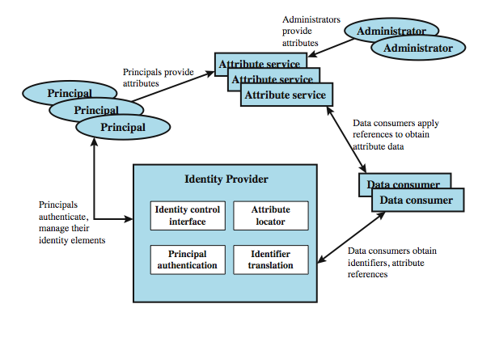
Identity Management
Notes:
Figure 4.8 illustrates entities and data flows in a generic identity management architecture. A principal is an identity holder. Typically, this is a human user that seeks access to resources and services on the network. User devices, agent processes, and server systems may also function as principals. Principals authenticate themselves to an identity provider. The identity provider associates authentication information with a principal, as well as attributes and one or more identifiers.
Increasingly, digital identities incorporate attributes other than simply an identifier and authentication information (such as passwords and biometric information). An attribute service manages the creation and maintenance of such attributes. For example, a user needs to provide a shipping address each time an order is placed at a new Web merchant, and this information needs to be revised when the user moves. Identity management enables the user to provide this information once, so that it is maintained in a single place and released to data consumers in accordance with authorization and privacy policies. Users may create some of the attributes to be associated with their digital identity, such as address. Administrators may also assign attributes to users, such as roles, access permissions, and employee information.
Data consumers are entities that obtain and employ data maintained and provided by identity and attribute providers, often to support authorization decisions and to collect audit information. For example, a database server or file server is a data consumer that needs a client's credentials so as to know what access to provide to that client.

Slide 41
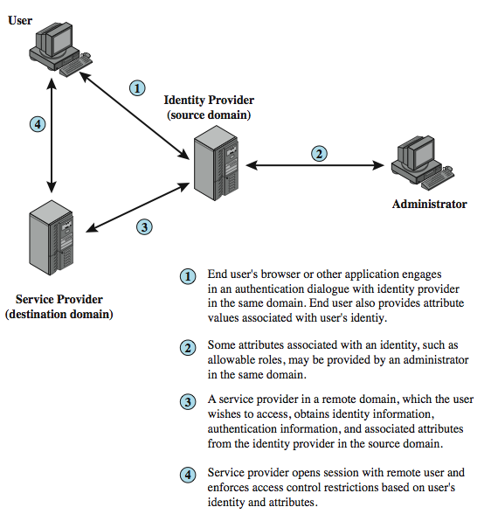
Identity Federation
Notes:
Identity federation is, in essence, an extension of identity management to multiple security domains. Federated identity management refers to the agreements, standards, and technologies that enable the portability of identities, identity attributes, and entitlements across multiple enterprises and numerous applications and supporting many thousands, even millions, of users. Stallings Figure 4.9 illustrates entities and data flows in a generic federated identity management architecture. The identity provider acquires attribute information through dialogue and protocol exchanges with users and administrators. Identity management enables the user to provide this information once, so that it is maintained in a single place and released to data consumers in accordance with authorization and privacy policies. Service providers are entities that obtain and employ data maintained and provided by identity providers, often to support authorization decisions and to collect audit information. A service provider can be in the same domain as the user and the identity provider. The power of this approach is for federated identity management, in which the service provider is in a different domain.

Slide 42
Standards Used
Security Assertion Markup Language (SAML)
  XML-based language for exchange of security information between online business partners
Part of OASIS (Organization for the Advancement of Structured Information Standards) standards for federated identity management
  e.g. WS-Federation for browser-based federation
Need a few mature industry standards
Notes:
Federated identity management uses a number of standards as the building blocks for secure identity exchange across different domains or heterogeneous systems. In essence, organizations issue some form of security tickets for their users that can be processed by cooperating partners. Identity federation standards are thus concerned with defining these tickets, in terms of content and format, providing protocols for exchanging tickets and performing a number of management tasks. These tasks include configuring systems to perform attribute transfers and identity mapping, and performing logging and auditing functions. The principal underlying standard for federated identity is the Security Assertion Markup Language (SAML), which SAML is an XML-based language that defines the exchange of security information between online business partners. SAML conveys authentication information in the form of assertions about subjects. Assertions are statements about the subject issued by an authoritative entity.
SAML is part of a broader collection of standards being issued by OASIS (Organization for the Advancement of Structured Information Standards) for federated identity management. For example, WS-Federation enables browser-based federation; it relies on a security token service to broker trust of identities, attributes, and authentication between participating Web services. The challenge with federated identity management is to integrate multiple technologies, standards, and services to provide a secure, user-friendly utility. The key, as in most areas of security and networking, is the reliance on a few mature standards widely accepted by industry. Federated identity management seems to have reached this level of maturity.

Slide 43
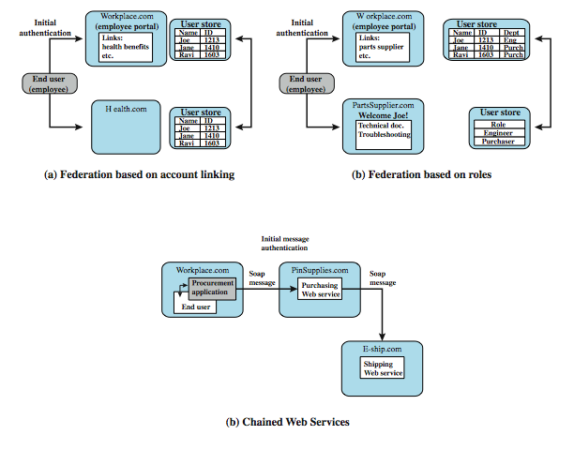
Federated Identity Examples
Notes:
To get some feel for the functionality of identity federation, we look at three scenarios, taken from [COMP06] (more details in text).
In the first (Figure 4.10a), Workplace.com contracts with Health.com to provide employee health benefits. An employee signs on and authenticates to Workplace.com. The two organizations federated and cooperatively exchanges user identifiers. Health.com maintains user identities for every employee at Workplace.com and associates with each identity health benefits info & access rights.
Figure 4.10b shows another browser-based scheme. PartsSupplier.com is a regular supplier of parts to Workplace.com. A role-based access control (RBAC) scheme is used. An engineer of Workplace.com authenticates to Workplace.com and clicks on a link to access information at PartsSupplier.com. For this scenario, PartSupplier.com does not have identity information for individual employees at Workplace.com. Rather, the linkage between the two federated partners is in terms of roles.
The scenario in Figure 4.10c can be referred to as document-based. Workplace.com has a purchasing agreement with PinSupplies.com which has a business relationship with E-Ship.com. An employee of WorkPlace.com signs on and is authenticated to make purchases. The procurement application generates an XML/SOAP order document, and inserts into the header the user's credentials and Workplace.com's organizational identity. It then posts the message to the PinSupplies.com's purchasing Web service. This service authenticates the incoming message and processes the request, sending a SOAP message to its shipping partner to fulfill the order.

